Slide 1
JANUARY FINANCIAL/ ENROLLMENT REPORT
Board Meeting January 25, 2024

Slide 2
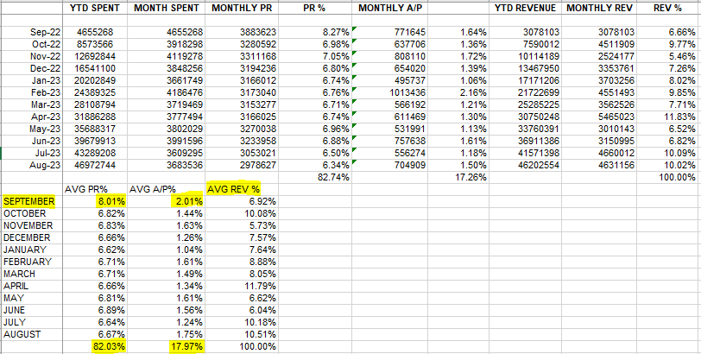
Example of Average Calculations for Payroll, Accounts Payable and Revenues

Slide 3
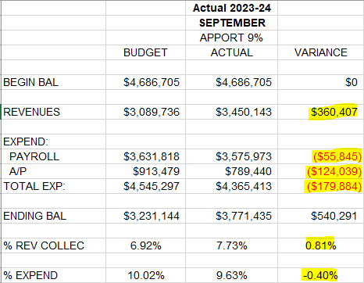
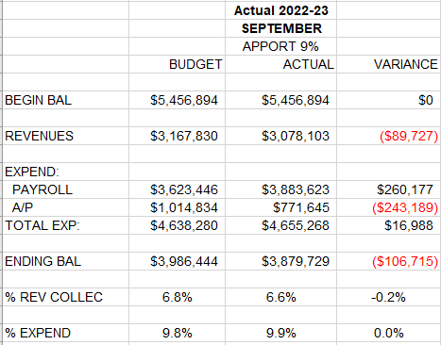
Monthly Revenues, Expenditures and Fund Balance Compared to Projected - September

Slide 4
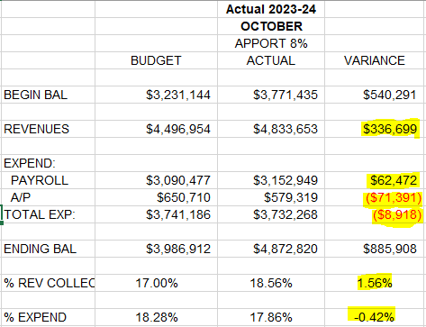
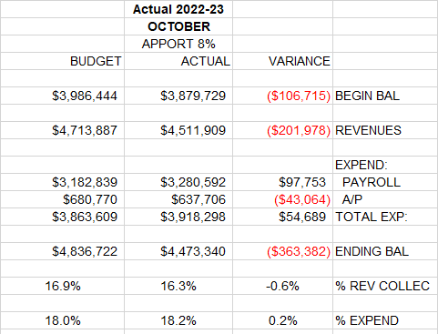
Monthly Revenues, Expenditures and Fund Balance Compared to Projected - October

Slide 5
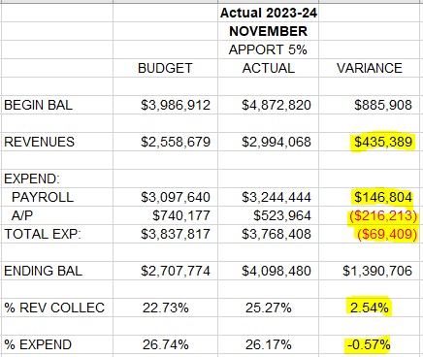
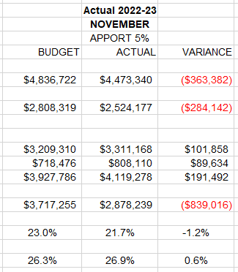
Monthly Revenues, Expenditures and Fund Balance Compared to Projected - November

Slide 6
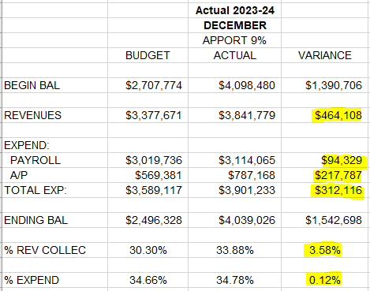
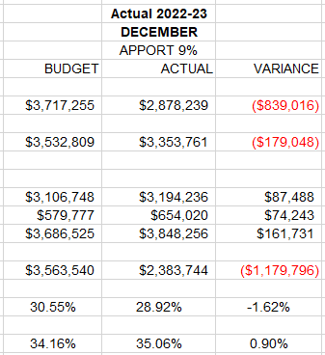
Monthly Revenues, Expenditures and Fund Balance Compared to Projected - December

Slide 7
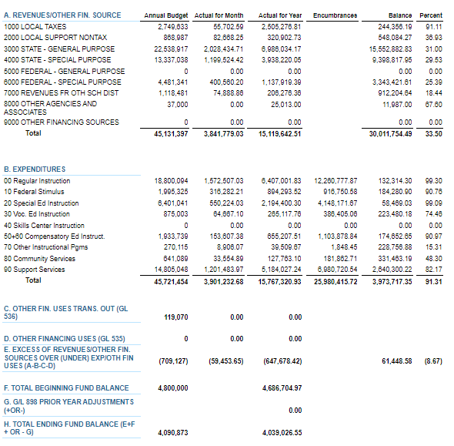
DECEMBER 2023 BUDGET STATUS REPORT – GENERAL FUND

Slide 8
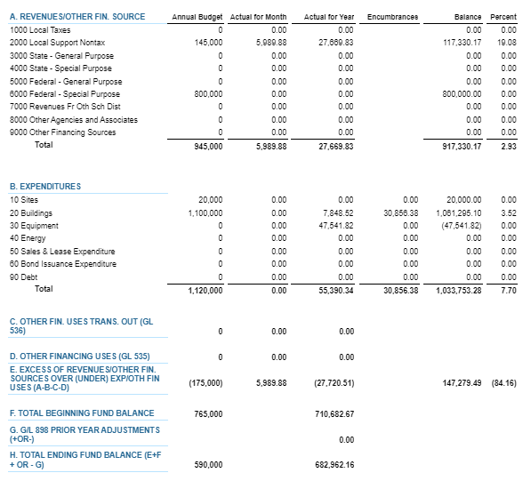
DECEMBER 2023 BUDGET STATUS REPORT – CAPITAL PROJECTS FUND

Slide 9
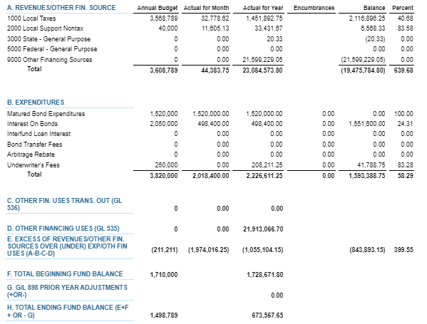
DECEMBER 2023 BUDGET STATUS REPORT – DEBT SERVICE FUND

Slide 10
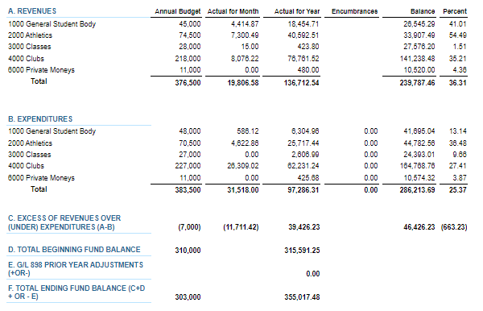
DECEMBER 2023 BUDGET STATUS REPORT – ASB FUND

Slide 11
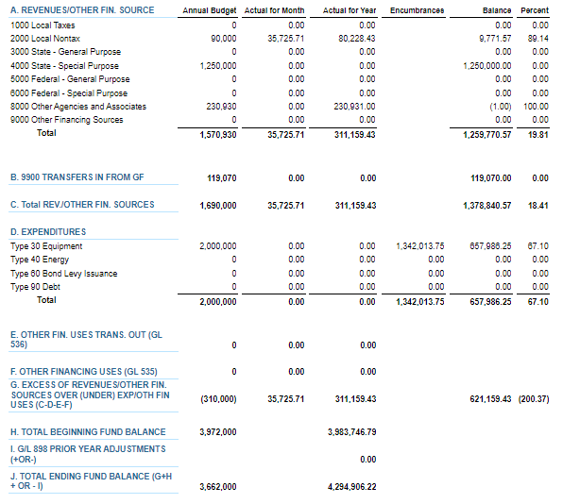
DECEMBER 2023 BUDGET STATUS REPORT – TRANSPORTATION VEHICLE FUND

Slide 12
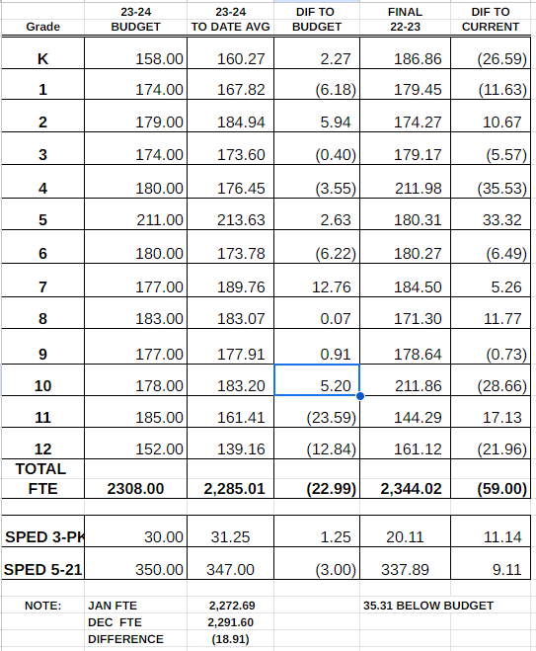
FTE ENROLLMENT – JANUARY 2024

Slide 13
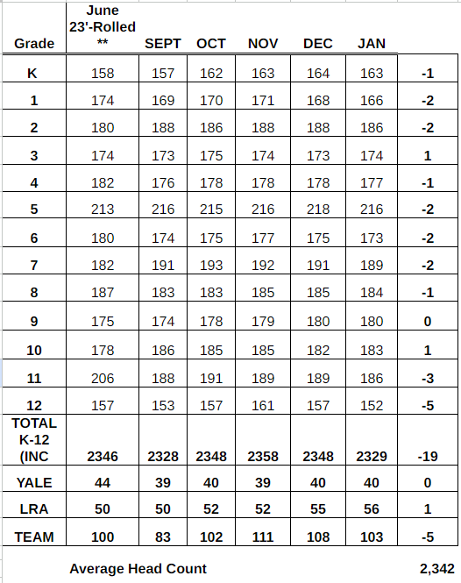
HEADCOUNT ENROLLMENT – JANUARY 2024

